Slide 1

Math & Science
Department
Welcome to the
ST. JOHN’S COLLEGE
JUNIOR COLLEGE

Slide 2
MEETING’S AGENDA
Opening Prayer
Welcome
Program Review
Attendance Policies
Academic-Changes Applications
Service Learning
Program Briefings
Choosing a Program & Initial enrollments
Q & A Segment
Final Announcements
Thank You

Slide 3
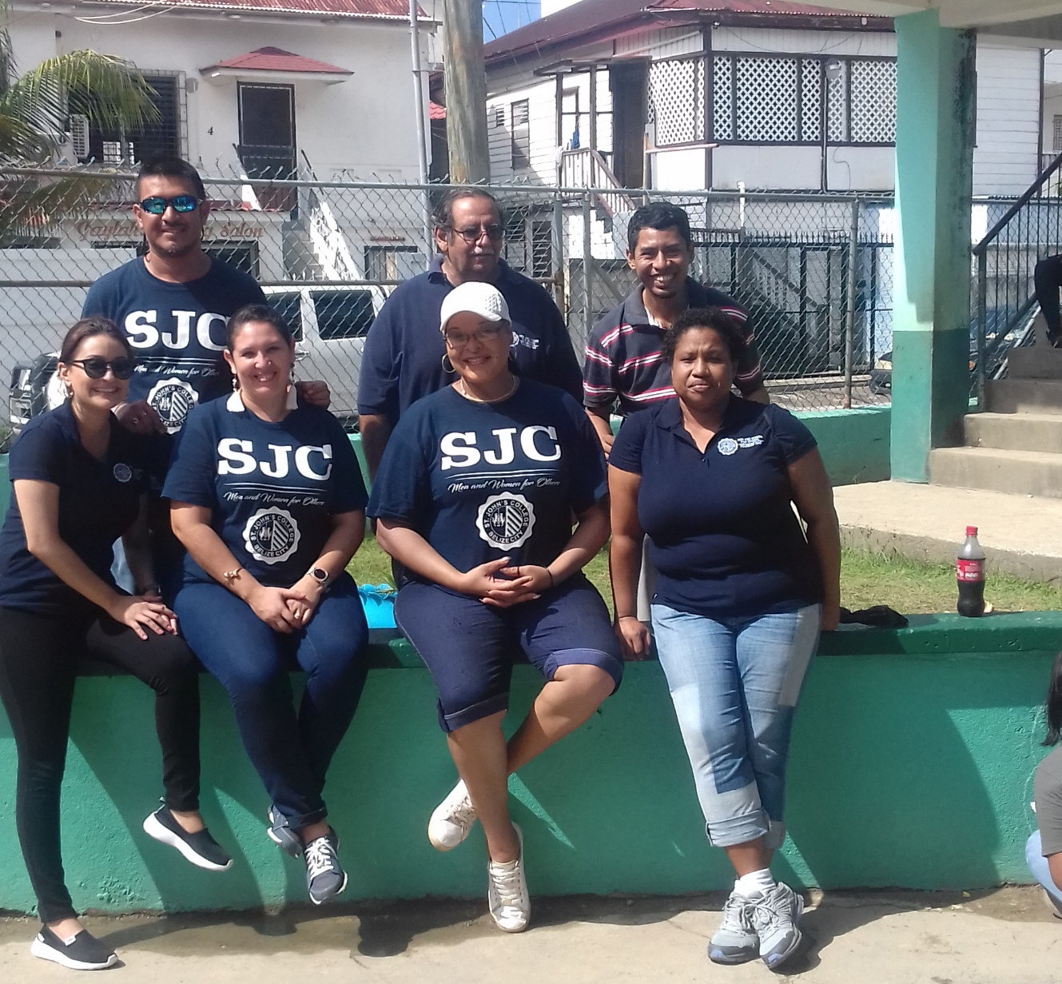
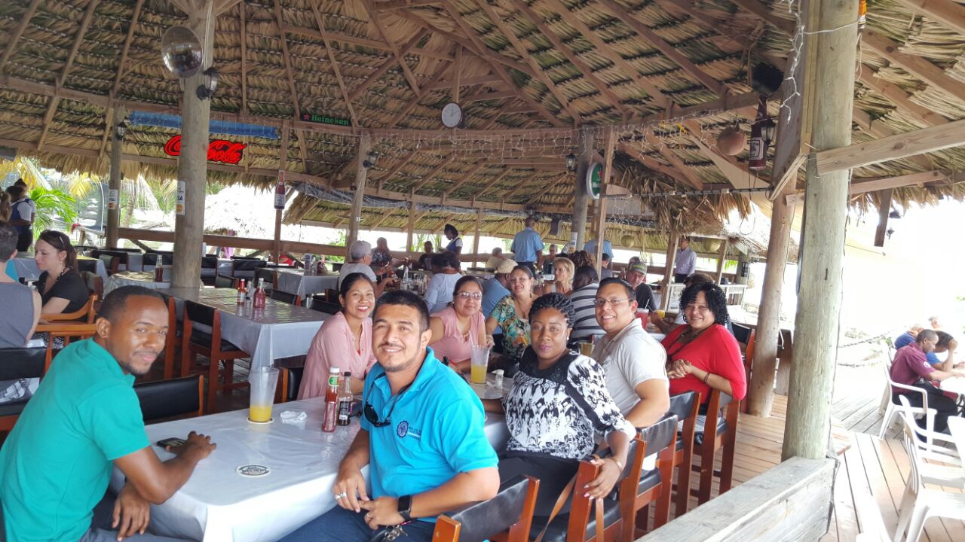
MATH & SCIENCE DEPARTMENT FACULTY & STAFF

Slide 4
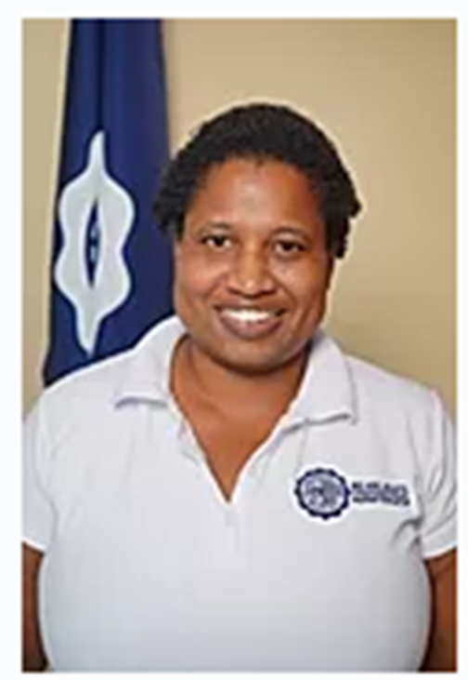
HEAD of DEPARTMENT (HoD)
&
MATH & PHYSICS
LECTURE
Mrs. DARLENE PETERS , M.Sc.

Slide 5
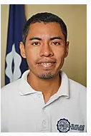
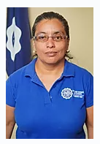
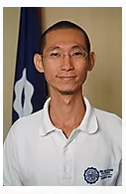
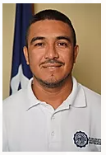
SJC JC MATH LECTURES
Mr. amir juarez . M. Sc.
MS. IRMA BRICENIO , M. Ed.
MR. JASON (Po-wei) Hsu M. Ed.
Mr. darsi Salazar . B. Sc.

Slide 6
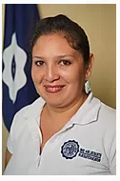
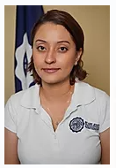
SJC JC BIOLOGY LECTURES
Ms. Aisha leiva , B. Sc.
Ms. Nerissa
Guerra , M. Sc.

Slide 7
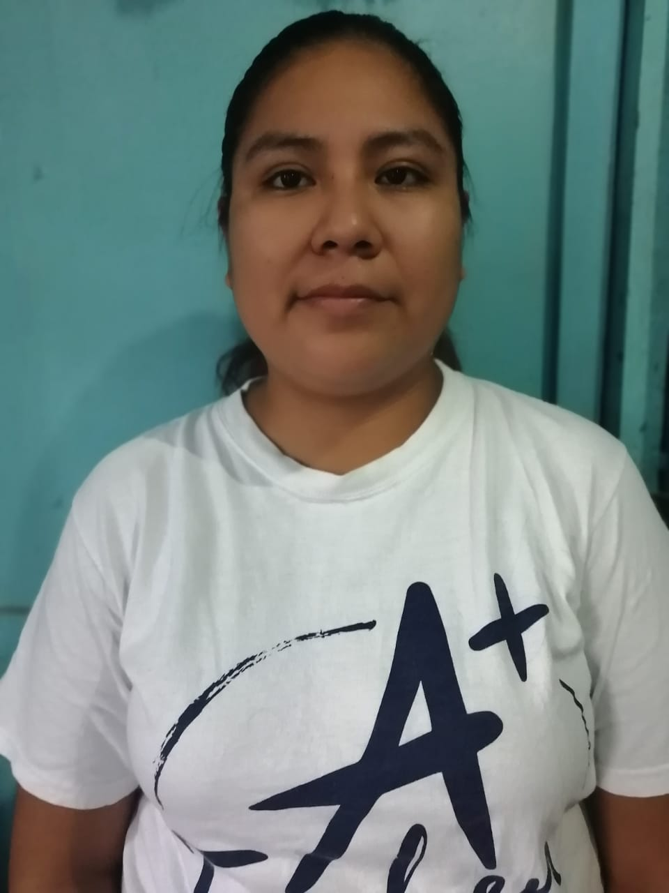
SJC JC CHEMISTRY LECTURES
Ms. Lucero cob , B. Sc.

Slide 8
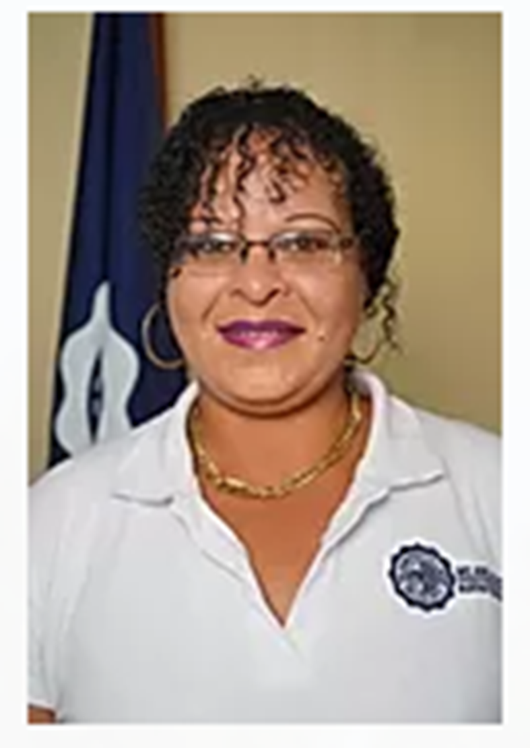
SJC JC
GENERAL SCIENCE LECTURE
MS. LIANY AYUSO , B. Sc.
MS. GERALDINE GODOY M. Sc.
SJC JC
ENVIRONMENTAL SCIENCE LECTURE

Slide 9
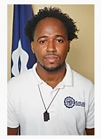

SJC JC SCIENCE LAB ASSISTANT
MR. RASHEED GARDINER
As. Sc.

Slide 10
SJC ETHOS STATEMENT
Choosing to come to St. John’s College means making a choice to join a distinctive community. As a Jesuit and Catholic institution, St. John’s College places special emphasis on the dignity and worth of every person and the love of truth. Membership in this community carries with it high expectations regarding the ways in which each person will act both within and beyond the institution and its facilities.

Slide 11
MATH & SCEINCE DEPARTMENT MISSION STATEMENT
The Math & Science Department is a student-oriented department that introduces the students to the applications of principles in physics, chemistry, biology, mathematics, and environmental science. The mission of the Department is to present science as a rational and systematic observation, identification, description, experimental investigation, and theoretical explanation of natural phenomena despite the program enrolled in.
As a department dedicated to achieving excellence, we stress the importance of critical thinking, logical reasoning, and mathematical manipulations. Students are guided in developing their ability to ask and answer questions, and, enhance their current knowledge and technical skills in scientific inquiry approach, so as to design and execute scientific investigations and apparatuses. The faculty challenges the student to view science as an interdisciplinary study applicable to society and their professional and personal development.

Slide 12

Programs
Biology and Chemistry
  Biology and Chemistry Major (79 Credits)
  Biology Major (74 Credits)
  Chemistry Major (75 Credits)
Math and Physics
  Math and Physics Major (75 Credits)
  Math Major (72 Credits)
  Math and Chemistry Major (77 Credits)
  Physics Major (78 Credits)
The CREDITS in RED is required for completion for graduation

Slide 13
Programs
Environmental Science
  Environmental Science Major (76 Credits)
    Combination of scientific studies of LAND, AIR & WATER

Slide 14
Programs
  Interdisciplinary Science
    Students design their science degree . . .
  Choice A (74 credits)
  - with Year 1 & Year 2 Options
  - Year 1 – minimum of 25 credits
  - Year 2 – minimum of 11 credits
    Math requirement is Mth 103 (Intermediate Algebra)
    A combination of ALL science major courses (except mathematics) and computer science courses
    Eligible for 2 Units of CAPE.
    MUST satisfy GENERAL CORES & ALL Pre-requisites.

Slide 15
Programs
  Interdisciplinary Science
  Choice B (74 credits)
  - with Year 1 & Year 2 Options
  - Year 1 – minimum of 25 credits
  - Year 2 – minimum of 11 credits
    A combination of ALL science major courses, Math major courses and computer science courses
    Math requirement is Mth 105 (Algebra for Sciences)
    Eligible for 2 Units of CAPE.
    MUST satisfy GENERAL CORES & ALL Pre-requisites.

Slide 16

Interdisciplinary PROGRAM… important to know
What is it?
Fairly NEW Science Degree PROGRAM that covers more than one field of study in science.
Designed for:
Students who have a strong background in the Science disciplines (Math, Bio, Chem, Physics, ENS, IT)
Students who may have a career goal in mind that requires a unique combination of science/mathematics.
Students who have not yet decided on a career path but know it will involve some area in science.
Students who have a chosen career path in science and are trying to earn credit towards it when they apply to their universities of choice.

Slide 17
General core course
General Core Course (37 credits minimum)
      College Seminar - (1 credit)
      Computer Elective – (3 credits)
      English & Literature - (9 credits)
      Math - (6 / 7 credits)
      Philosophy - (3 credits)
      Theology - (6 credits)
      Social Science Elective - (6 / 7 credits)
      Language Elective - (3 credits)

Slide 18
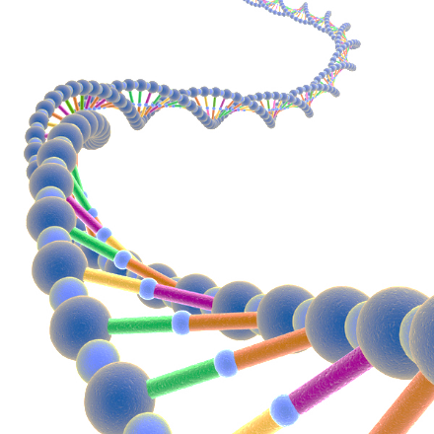
Professional Core
Biology
    BIO 131 Cellular Biology
    BIO 131L Cellular Biology LAB
    CHEM 140 Biochemistry
    CHEM 140L Biochemistry LAB
    ENS 120 Fundamental Ecological Principles with Field Work
    ENS 121 Environment and Society
    OR
    BIO 240 Plant Anatomy & Physiology
    BIO 240L Plant Anatomy & Physiology Lab
    BIO 231 Evolution and Biodiversity
    BIO 231L Evolution and Biodiversity LAB
    BIO 232 Genetics
    BIO 241 Human Anatomy and Physiology
    BIO 241L Human Anatomy and Physiology LAB
    BIO 242 Human Health and Disease

Slide 19

Professional Core
Chemistry
    BIO 131 Cellular Biology
    BIO 131L Cellular Biology LAB
    CHE 129 Principles of Chemistry II
    CHE 129L Principles of Chemistry II LAB
    CHEM 140 Biochemistry
    CHEM 140L Biochemistry LAB
    CHE 136 Fundamental Organic Chemistry
    CHE 230 Analytical Methods in Chemistry
    CHE 234 Organic Chemistry
    CHE 234L Organic Chemistry LAB
    CHE 239 Inorganic Chemistry
    CHE 239L Inorganic Chemistry LAB
    MTH 213 Calculus for the Life Sciences

Slide 20
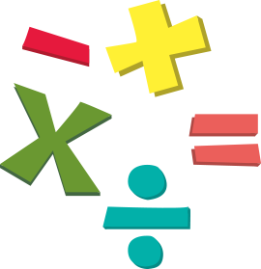
Professional Core
Mathematics
      MTH 105 Algebra for the Sciences
      MTH 115 College Algebra
      MTH 119 Trigonometry
      CIS 125 Principles of Programming I
      CIS 126 Principles of Programming II
      CRS/HIS Caribbean Studies: Caribbean Societies and Culture or Any 200 Level HIS Course
      CRS/BSR Caribbean Studies: Issues in Caribbean Development or 200 Level Lit Course or Belizean Studies Research Paper
      MTH 140 Analytic Geometry
      MTH 145 Calculus I
      MTH 236 Calculus II
      MTH 245 Probability and Statistics
      MTH 250 Further Sequences and Mathematical Modeling

Slide 21

Professional Core
Environmental Science
    BIO 131 Cellular Biology
    BIO 131L Cellular Biology LAB
    BIO 231 Evolution and Biodiversity
    BIO 231L Evolution and Biodiversity LAB
    CHE 129 Principles of Chemistry II
    CHE 129L Principles of Chemistry II LAB
    ENS 120 Fundamental Ecological Principles with Field Work
    ENS 121 Environment and Society
    ENS 122 Geography of Environmental Systems
    ENS 212 Sustainable Agriculture/ Agro-forestry
    ENS 216 Environmental Chemistry and Monitoring
    ENS 217 Marine and Fish Ecology
    ENS 221 Tropical Ecology Research
    ENS 241 Internship in Environmental Science

Slide 22

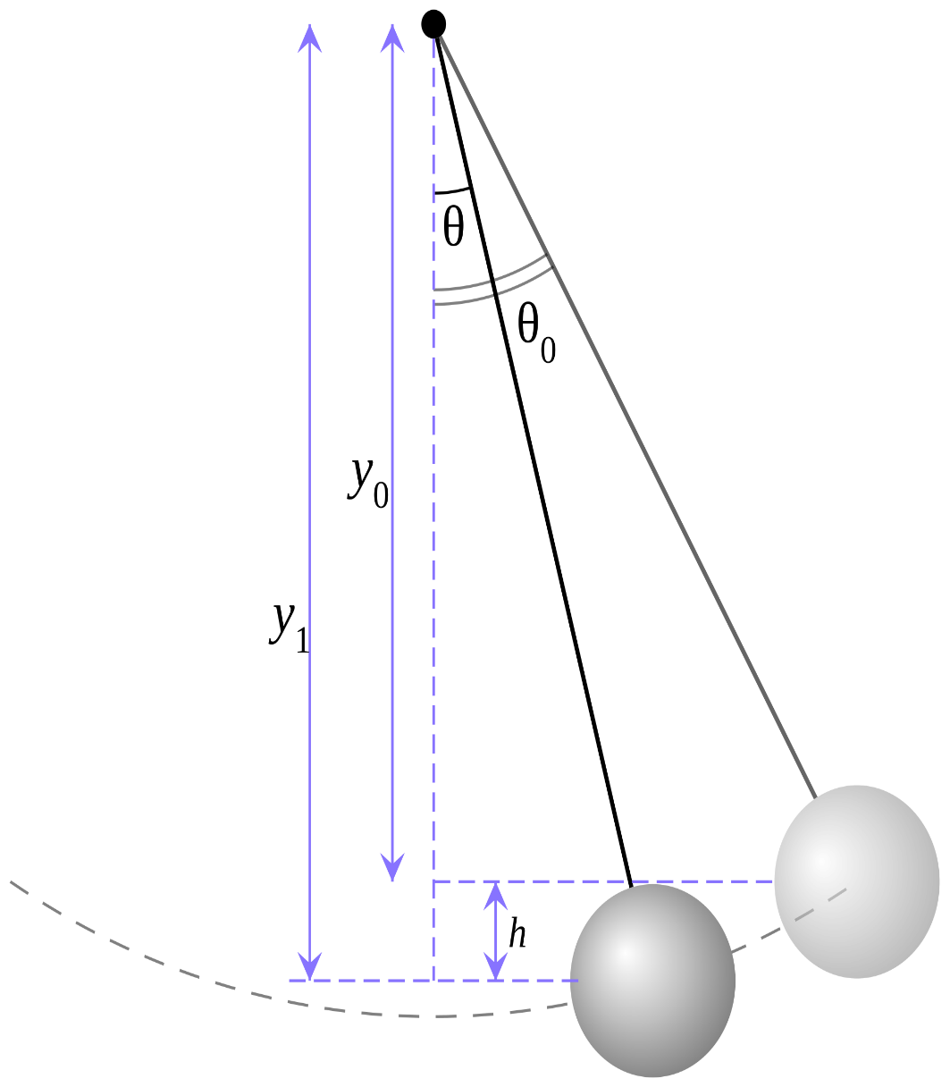
Professional Core
Physics
    MTH 115 College Algebra
    MTH119 Trigonometry
    MTH140 AnalyticGeometry
    MTH145 Calculus I
    MTH236 CalculusII
    MTH245 Probability and Statistics
    MTH250 Further Sequences and Mathematical Modeling
    PHY 116 Classical Mechanics for Scientists and Engineers
    PHY 116L Classical Mechanics for Scientists and Engineers LAB
    PHY 116R Classical Mechanics for Scientists and Engineers Recitation
    PHY 120 Introduction to Fluids, Materials and Thermodynamics
    PHY 130 Introduction to Analog and Digital Electronics
    PHY 130L Introduction to Analog and Digital Electronics LAB
    PHY205 Thermodynamics, Fluid Dynamics and MaterialsPhysics
    PHY216 Light,Waves and Oscillations
    PHY 216L Light,WavesandOscillations LAB
    PHY226 Electromagnetism
    PHY 226L Electromagnetism LAB
    PHY236 ModernPhysics
    PHY 236L ModernPhysics LAB

Slide 23
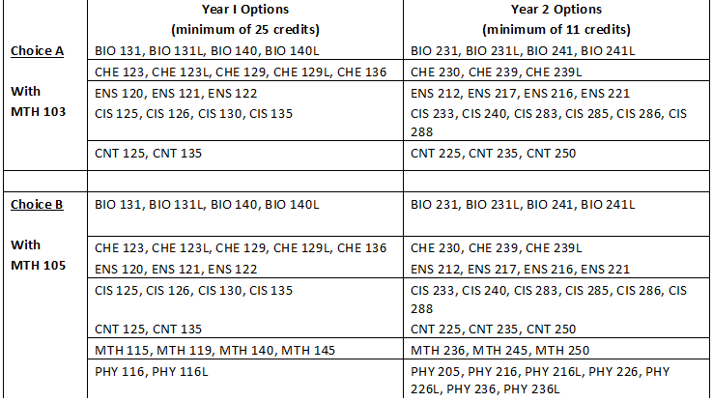
Professional Core
Interdisciplinary Science

Slide 24
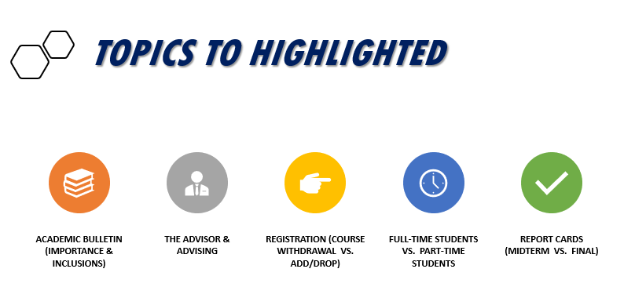
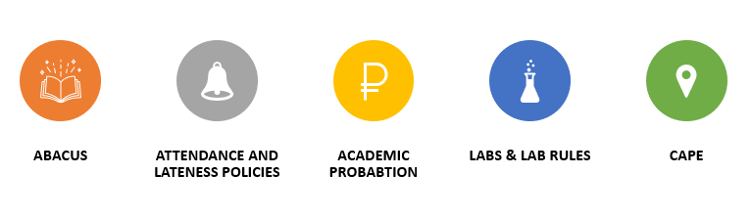

Slide 25
Credit Load Guideline
Full time: 18 - 20 credits per semester
Part time: 12 - 14 credits per semester
Probation: 12 credits per semester

Slide 26
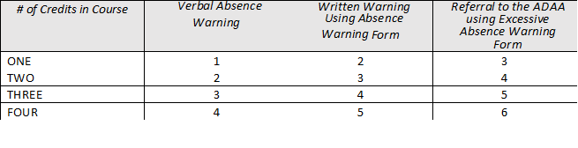
ATTENDANCE POLICY
Warning Slip are submitted to the Student & Associate Dean for Student Affairs.
A student whose absences exceed 12% of all scheduled contact hours will not be permitted to return to class and will be referred immediately by the course instructor, using an “Excessive Absence” form, to the Dean, who may take one of the following actions:
a) Instruct the student to withdraw from the course
b) Reinstate the student to the class on conditions

Slide 27
ACADEMIC PROBATION
A student who is on academic probation means that:
  the student’s cumulative grade point average falls below 2.00;
A student who is placed on academic probation will be required to do the following:
  Meet with the Dean to discuss conditions for continued enrollment;
  Obtain permission from the Dean to add, drop, withdraw, or apply for incomplete grades or leave of absence from school.
  Limit the number of credits taken while on probation to twelve (12) for full -time students and six (6) for part-time students;
  Participate in the required number of workshops, courses, tutorials, or other academic initiatives aimed at improving study approaches;
  Meet other stipulated requirements at the discretion of the Dean.

Slide 28
ELECTRONIC COMMUNICATION POLICY
Definition of an Electronic Communication
Electronic Communication is the passing of information from one individual to another using an electronic communication device. This may take the form, but not limited to, emailing, texting, instant messaging, facetiming, web surfing, and video recording.
Use of an Electronic Communication Device
Use of an Electronic Communication Device implies any activity that requires the student to touch or look at the device, including making and receiving calls, sending text messages, playing games and consulting information displayed or stored in the memory.
Electronic Communication Device Use during Class Students
may not view or use an Electronic Communication Device during a class session unless such use has been authorized by the lecturer for a specific educational activity.

Slide 29

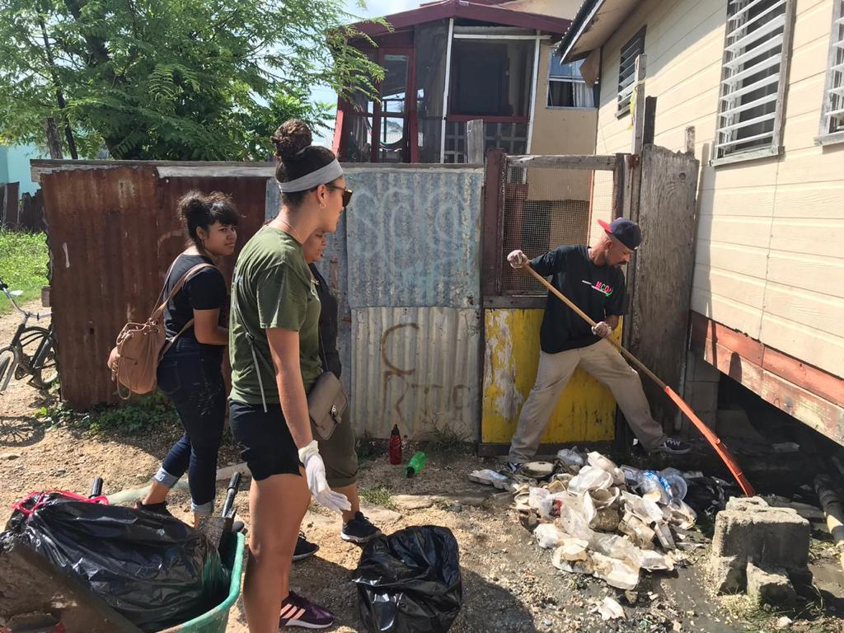
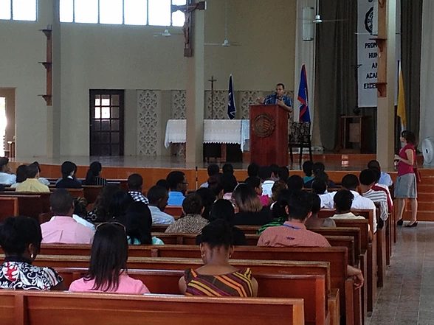
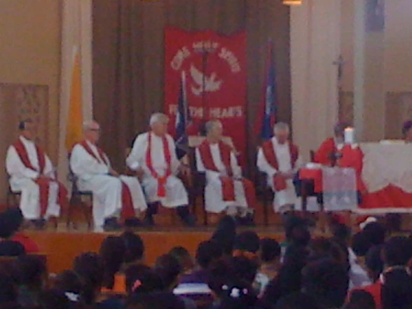
MAJOR EVENTS
MASS
CLUBS
FORUMS/LECTURES
COMMUNITY SERVICE
DEPARTMENT ACTIVITIES

Slide 30
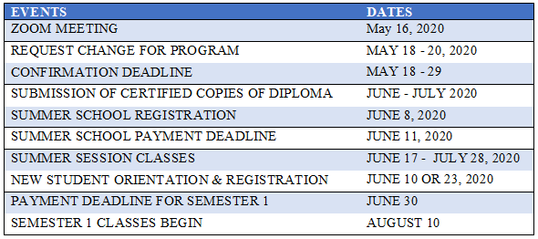

IMPORTANT DATES
May 05, 2022
May 12, 2022
May 19, 2022
June 9, 2022
June 9, 2022
June 10, 2022
June 16 – July 28, 2022
June 14 & June 15, 2022
June 24, 2022
August 8, 2022

Slide 31

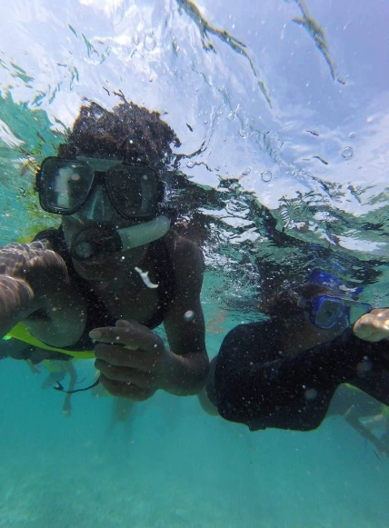
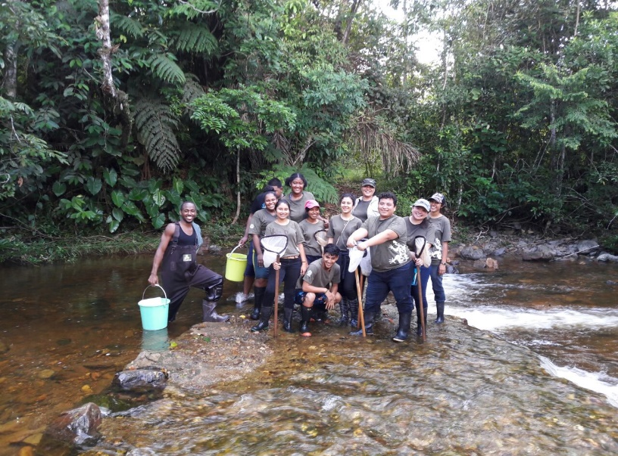
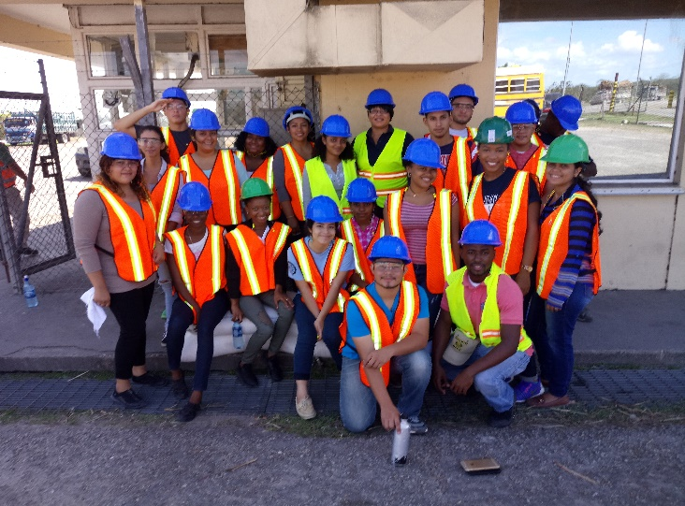
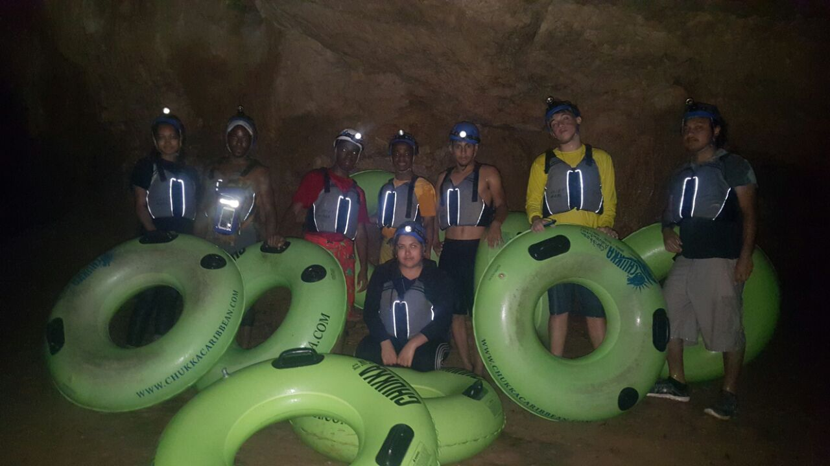
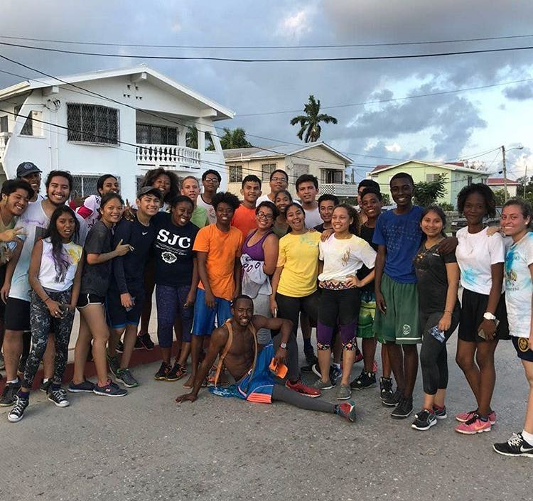
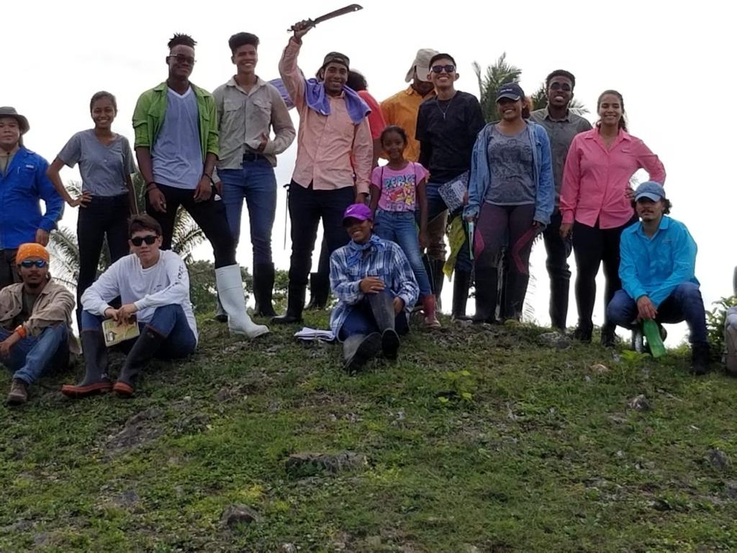
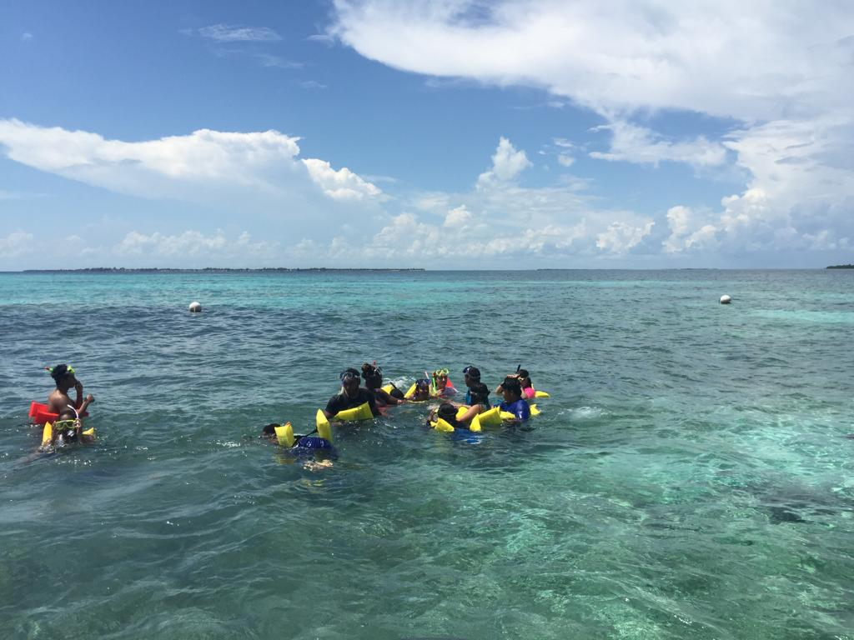
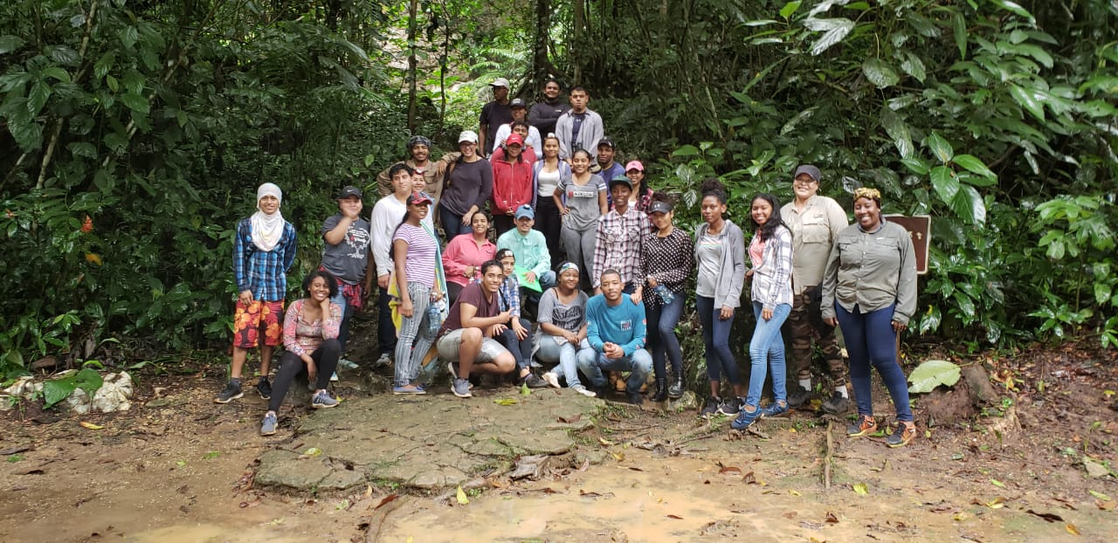
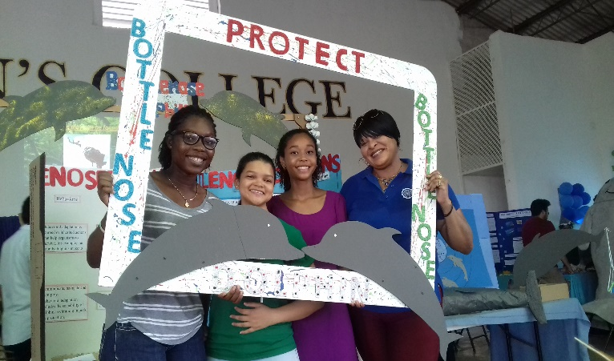
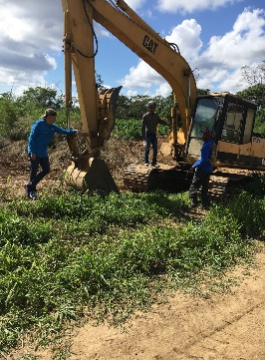
THE MATH & SCIENCE DEPARTMENT
@
WORK & PLAY

Slide 32

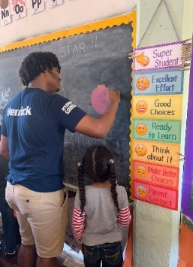
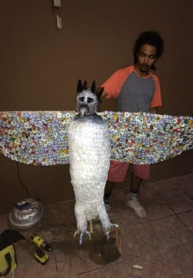
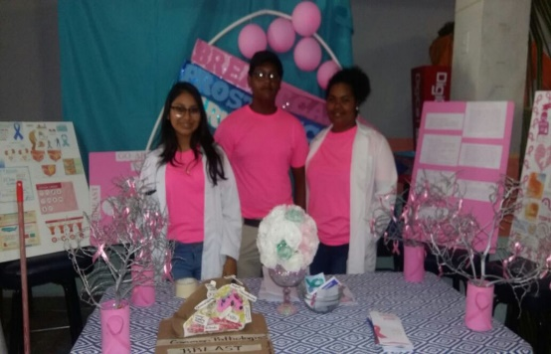
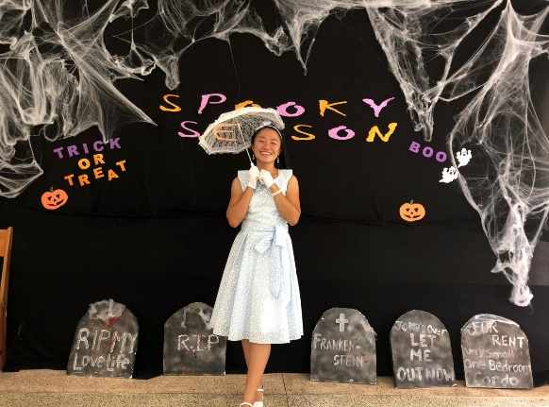
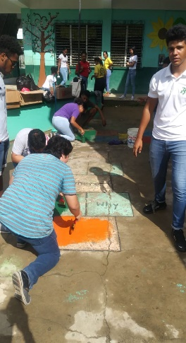
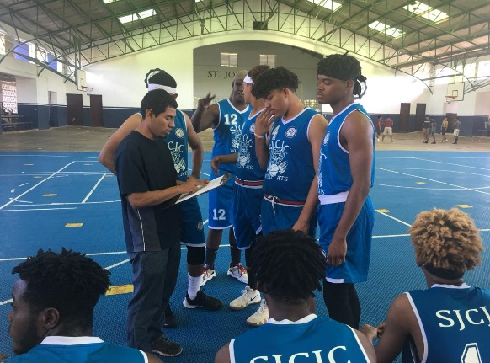
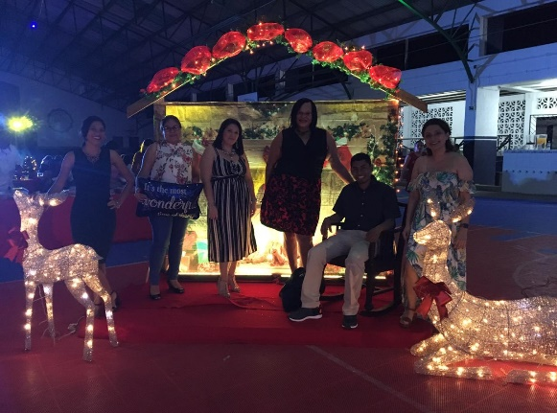

Slide 33
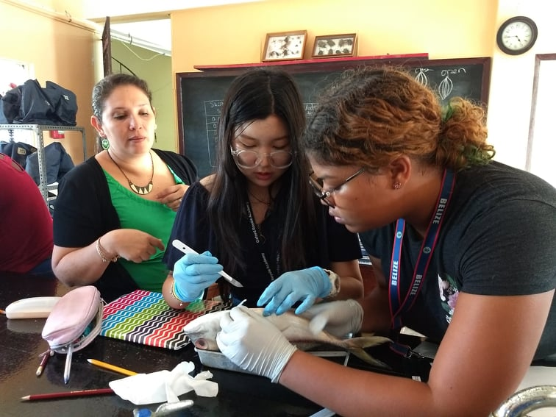
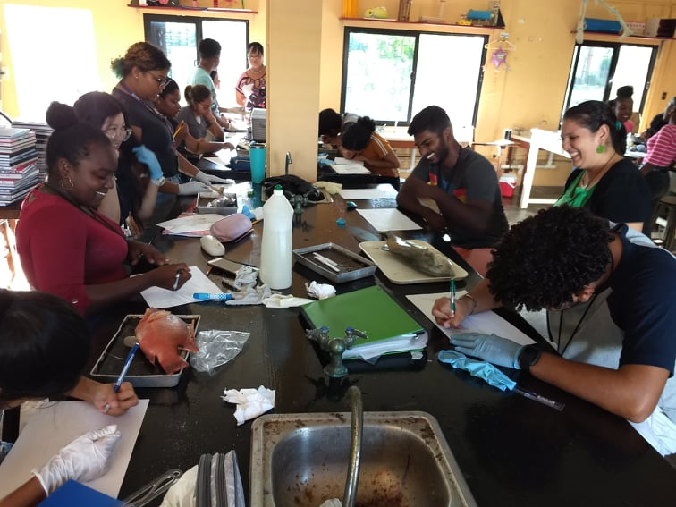
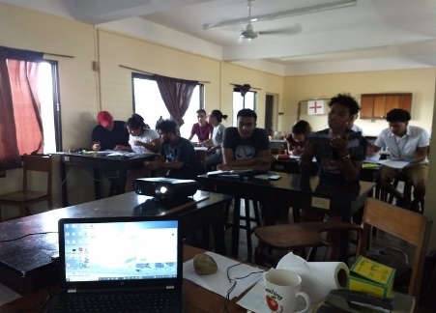
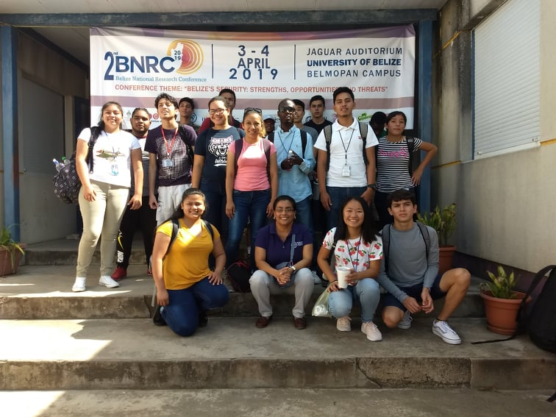
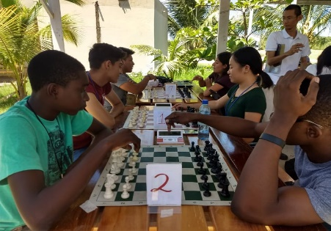
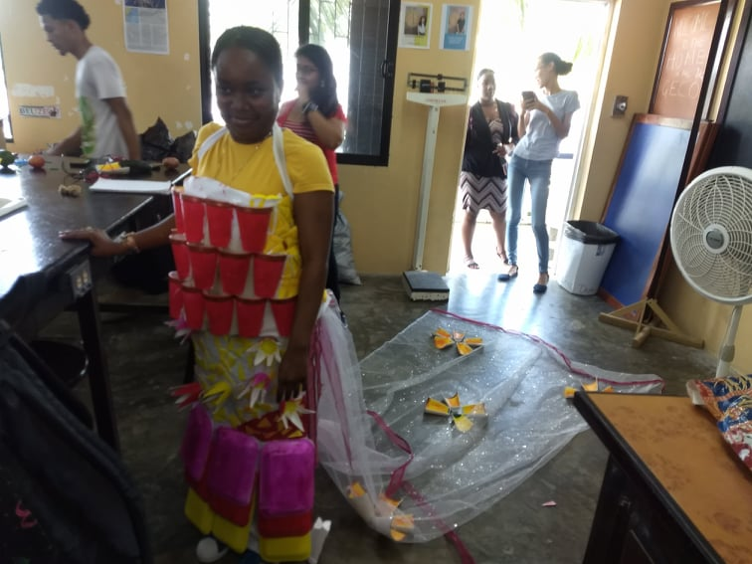
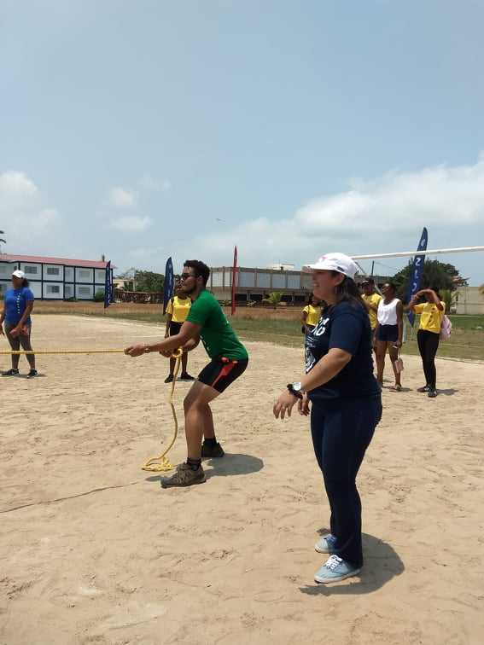
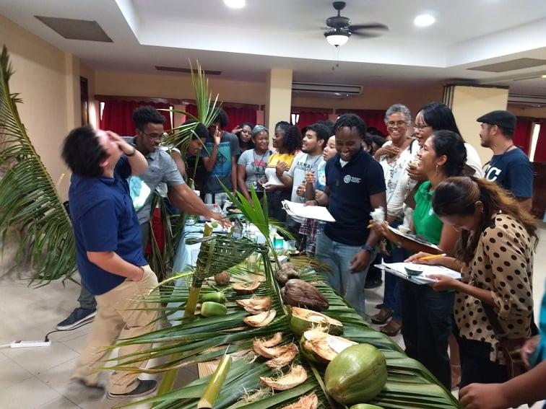
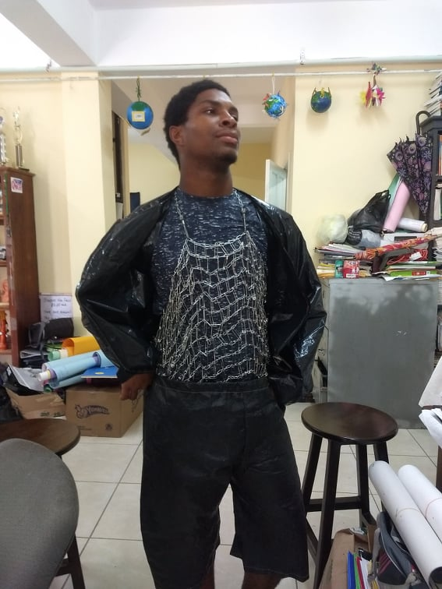
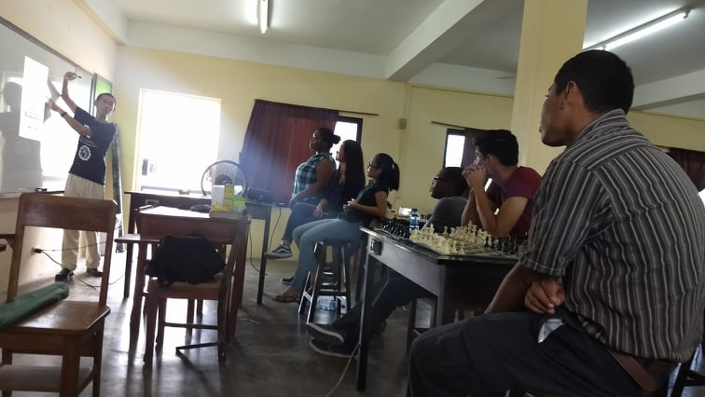

Slide 34
THANKS FOR CHOOSING
THE MATH & SCIENCE DEPARTMENT
BUILD RELATIONSHIPS
SERVE WITH PRIDE
LEAD WITH CONFIDENCE &
INSPIRE LIVES!

