Slide 1
GENERAL CORE
Minimum of 37 credits
College Seminar- 1 credit
Computer Elective - 3 credits
English & Literature - 9 credits
Math - 6/7 credits
Philosophy - 3 credits
Theology- 6 credits
Social Sciences - 6/7 credits
Language Elective - 3 credits

Slide 2
Introducing
The seven disciplines of social sciences at SJCJC

Slide 3
Sociology
The scientific study of human social behavior, groups and society.

Slide 4
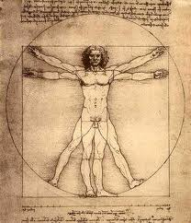
Psychology
The scientific study of the human mind, personality and individual behaviour.

Slide 5
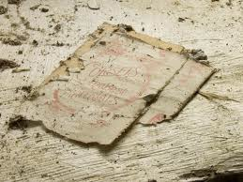
History
A record and analysis of the personalities and events of the past in a society.

Slide 6
Economics
Concerned with the production and distribution of goods and services, demand and supply, pricing, money and trade.

Slide 7
Criminal Justice
Concerned with systems, practices and institutions designed to control, deter, mitigate and punish crime.

Slide 8
International Relations
Concerned with relations across boundaries of nation-states to allow nations to cooperate, pool resources and share information to face global
issues.

Slide 9
Law
Concerned with systems of rules created and enforced through social or governmental institutions to regulate practices and rules of conduct between the organs of the government and subjects of the
state.

Slide 10
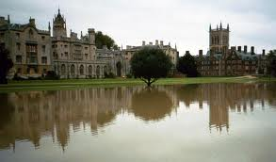
History

Slide 11
The Caribbean and the Atlantic World

Slide 12
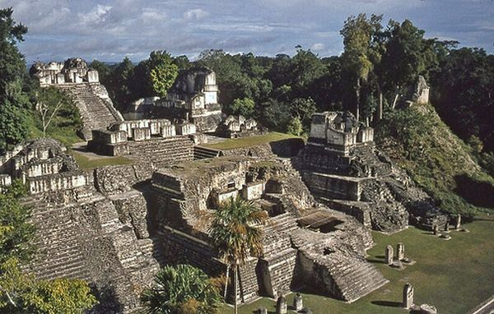
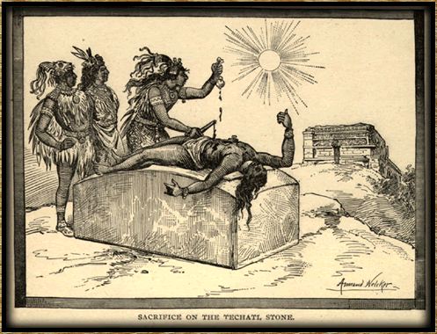
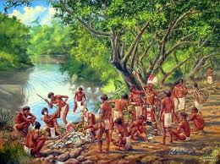
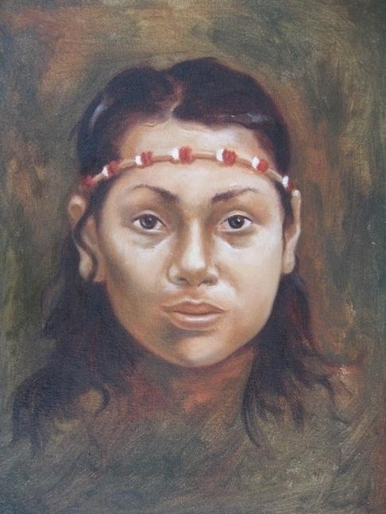
INDIGENOUS PEOPLES
MAYA
AZTECS
TAINO
KALINAGO

Slide 13
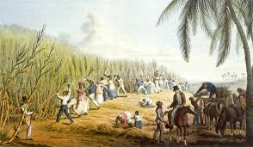
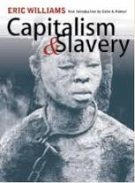
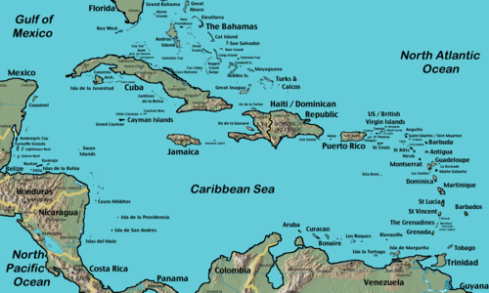
CARIBBEAN – SUGAR AND SLAVERY

Slide 14
The Development of Africa

Slide 16
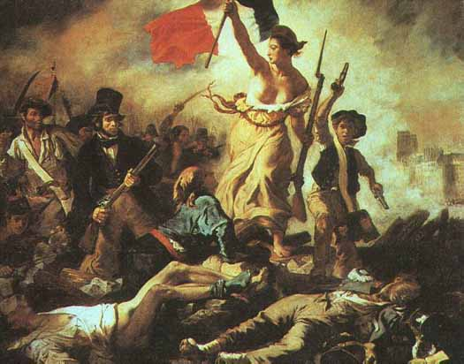
FRANCE 1789
Liberty
Equality
Fraternity

Slide 17
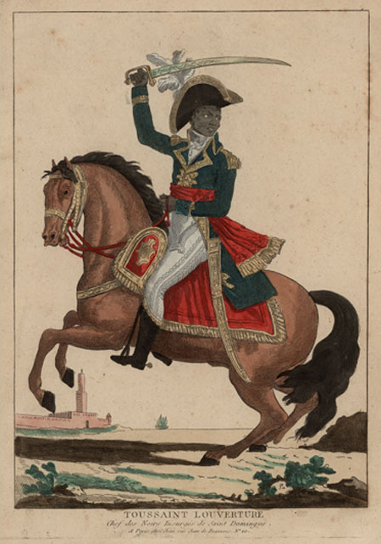
HAITI 1791
The Slave Uprising and the First Independent Black Nation of the Americas

Slide 18
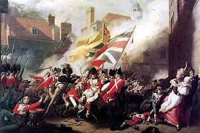
AMERICA 1776
“We hold these truths to be self-evident: That all men are created equal” Declaration of Independence1776

Slide 19
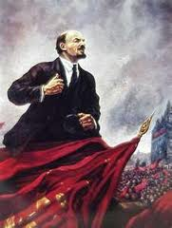
RUSSIA 1917

Slide 20
CUBA 1959

Slide 21
CONFLICT in the 20th CENTURY

Slide 23
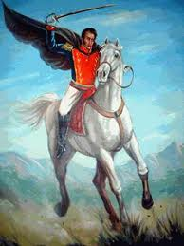
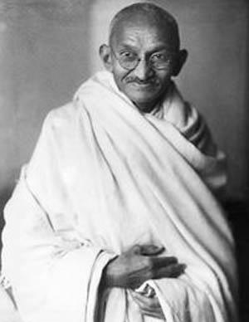
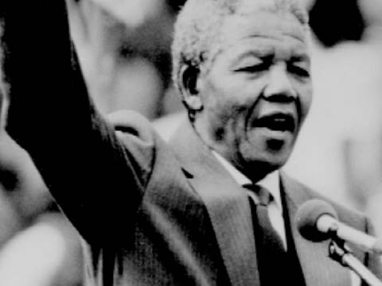
AND LIBERATION

Slide 24
ECONOMICS

Slide 28
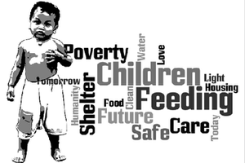
ALLEVIATING POVERTY

Slide 29
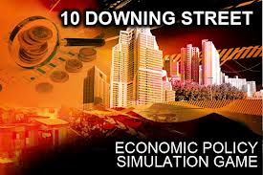

Slide 30
SOCIOLOGY

Slide 31
SOCIETY, CULTURE
and SOCIAL ISSUES…

Slide 32
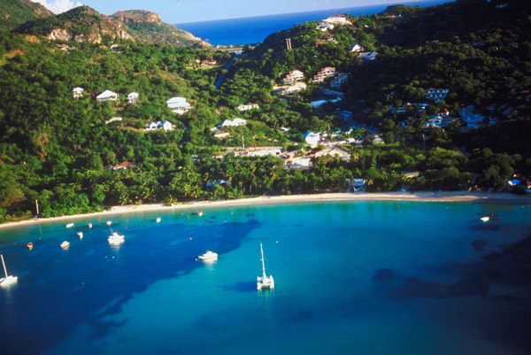
WHO ARE WE?
CULTURE & IDENTITY
“Ah who we?”

Slide 33
BEHAVIOURAL LAWS
What makes us “us”?
SOCIAL RESEARCH

Slide 34
WHAT MAKES US DIFFERENT?
SOCIAL STRATIFICATION & MOBILITY

Slide 35
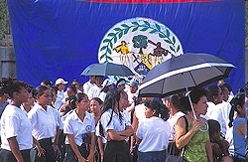
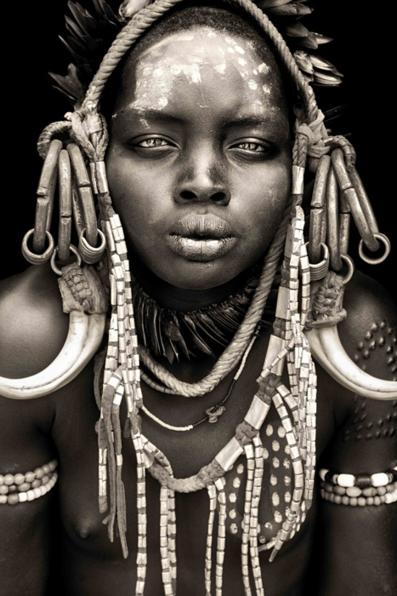
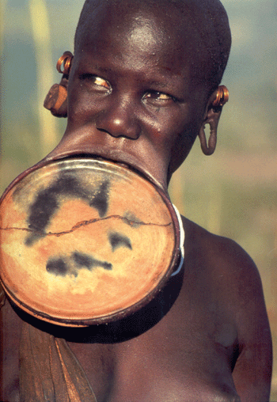

Slide 36
WHAT ARE CURRENT POPULATION TRENDS & PATTERNS?
POPULATION STUDIES

Slide 37
DEVIANCE & CRIME

Slide 38
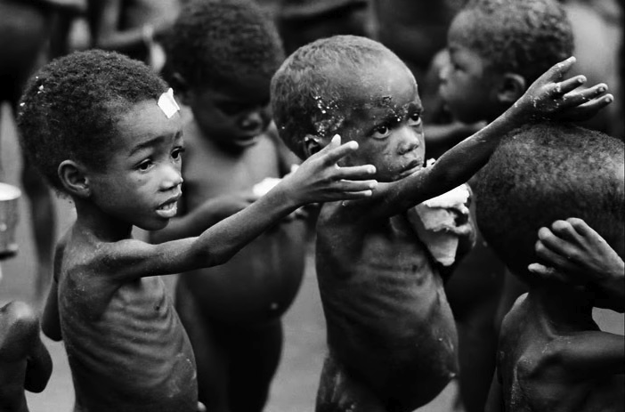
SOCIAL DEVELOPMENT & POVERTY

Slide 40
SOCIAL INSTITUTIONS

Slide 41
FAMILY AND EDUCATION

Slide 42
CHURCH AND STATE

Slide 43
babysitting

Slide 44
PSYCHOLOGY

Slide 45
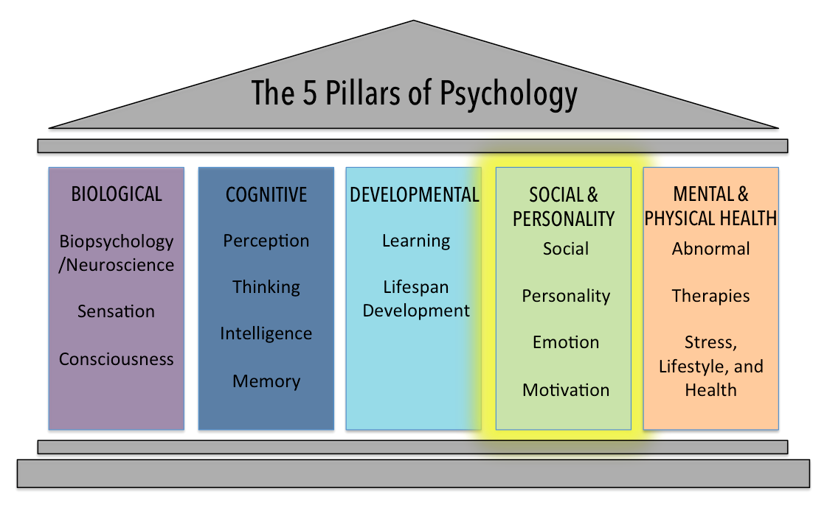

Slide 46
Fields of Psychology
Clinical
Academic
Educational

Slide 48
INTRODUCTION TO PSYCHOLOGY

Slide 49
DEVELOPMENTAL PSYCHOLOGY

Slide 50
HEALTH PSYCHOLOGY

Slide 51
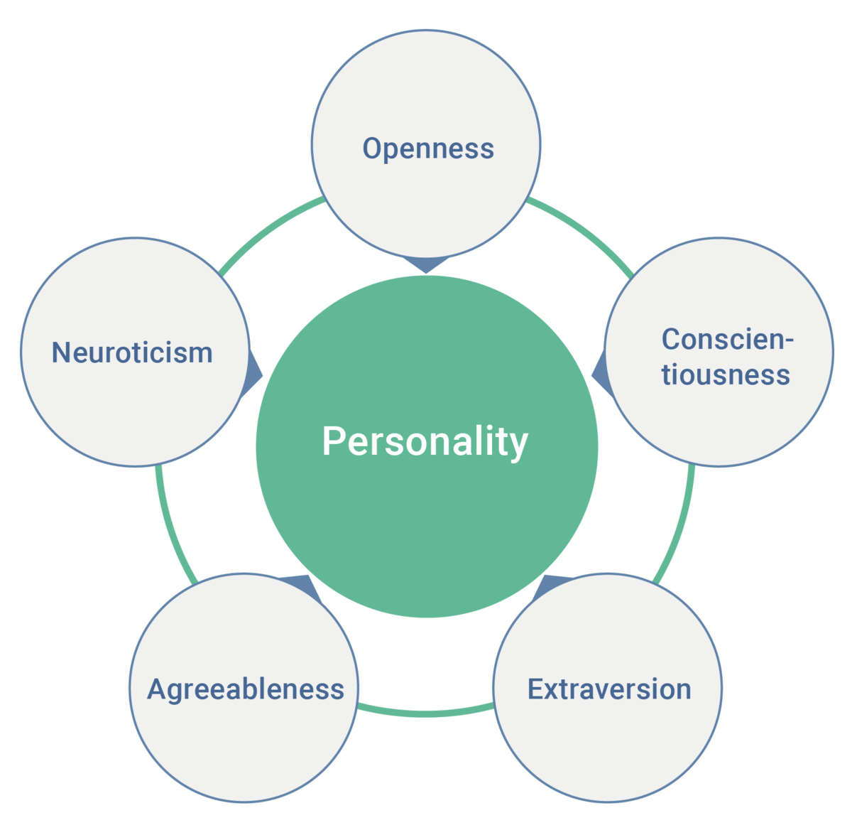
PERSONALITY PSYCHOLOGY

Slide 52
SOCIAL PSYCHOLOGY

Slide 53
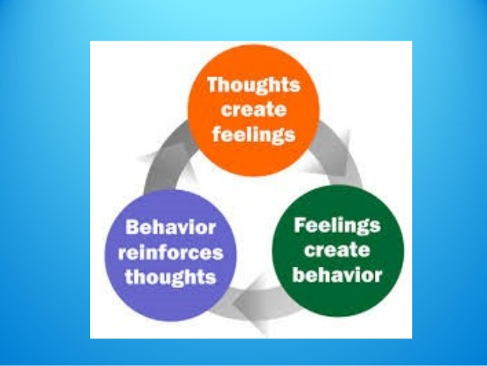
ABNORMAL PSYCHOLOGY

Slide 54
CRIMINAL JUSTICE

Slide 55
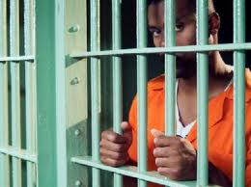
JUSTICE , LAW
TRENDS IN CRIME…

Slide 56
CRIMINOLOGY

Slide 57
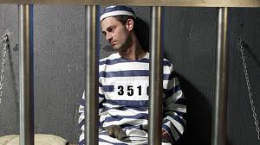
CORRECTIONS

Slide 58
CRIMINAL LAW

Slide 60
CHILD AND DOMESTIC ABUSE

Slide 61
DEVIANCE & CRIME

Slide 62
INTERNATIONAL RELATIONS

Slide 64
VIRTUAL FIELD TRIPS

Slide 65
PEACEKEEPING
Notes:
Ebooks

Slide 66
POWER, AUTHORITY AND GOVERNMENT IN IR

Slide 67
LAW

Slide 70
Notes:
Law library resources, e-books and legislations (www.belizelaw.org)

Slide 71
Making Your Choice
WHICH PROGRAM?

Slide 72
ONE MAJOR OR TWO?
Single Majors
History
Sociology
Psychology
Economics
Criminal Justice
International Relations
Law
Double Majors
History & Economics
History & Sociology
Psychology & Sociology
Sociology & Economics

Slide 73
Students choosing a single major take a wider variety of courses.
Single majors are approximately 71-74 credits.
Double majors are approximately 77-78 credits

Slide 74
Do you want to do CAPE?

Slide 75
CAPE
Caribbean Examinations council
Students planning to go to the U.W.I. OR
who want to compete for the Open Scholarship should aim for SIX Units
CAPE qualifications make it easier to work in CARICOM countries and may lead to a higher pay scale in government service.
CAPE – Caribbean Advanced Proficiency Examination

Slide 76
CAPE SUBJECTS
Caribbean Studies (1)
History (2)
Sociology (2)
Economics (2)
Law (2)
and
Communication Studies (1)
Note: Psychology, Criminal Justice & International Relations
are not subjects offered in the
CAPE exam.

Slide 77
Economics
Requires a strong Math background
Students requiring MTH 101 cannot take Economics.
Useful for careers in
Public policy- Policy Analyst
Finance- Credit and Financial Analyst
Economic Consultant

Slide 78
Criminal Justice, Law & International Relations
-Requires extensive reading
Leads to professional opportunities in
-Criminal Justice field
-Law ( Judicial System)
-International Relations ( Foreign Affairs)
All can be used as a foundation
to pursue Law.

Slide 79
Psychology
The most “scientific” of the social science majors.
Some U.S. schools do not accept all SJCJC psychology courses credits.
SJCJC has an articulation agreement with Memorial University (Grenfell Campus) to facilitate transfer of credits so that our students can complete their program in two years.
-Provides foundational knowledge for a higher degree in counselling, psychology and psychiatry.

Slide 80
History
Requires lots and lots of reading and analysis
Useful for careers in
Law
Education
Archaeology
Politics and Public Service

Slide 81
Sociology
Also requires lots of reading
Useful for careers in
Social work
Public service
National Development
Education
Business

Slide 82
IMPORTANT DATES
May 3, 2022

Slide 83
ANY QUESTIONS?

